Slide 1
Student Bank
Team: YesProfessorImHere
Team member: Zhifei Li, Junwei Dai, Yeqian Liu, Xinyue Yuan

Slide 2
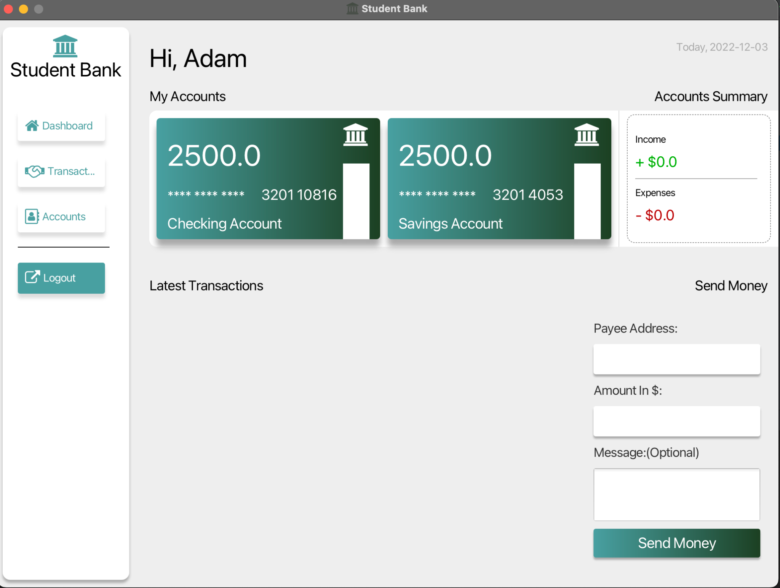
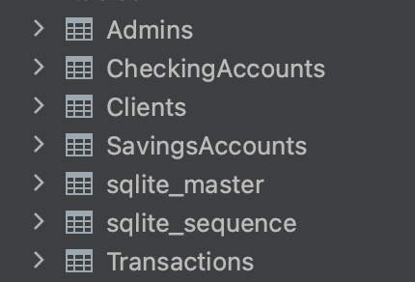
Abstract
The purpose of the banking system is to provide an easy way for people to save their money, and transfer money
Our application have 6 screens. And we used Scene Builder to edit our fxml file.
We used Sqlite as our database and it contains 5 core table.
Transaction, Account management is our core founction

Slide 3
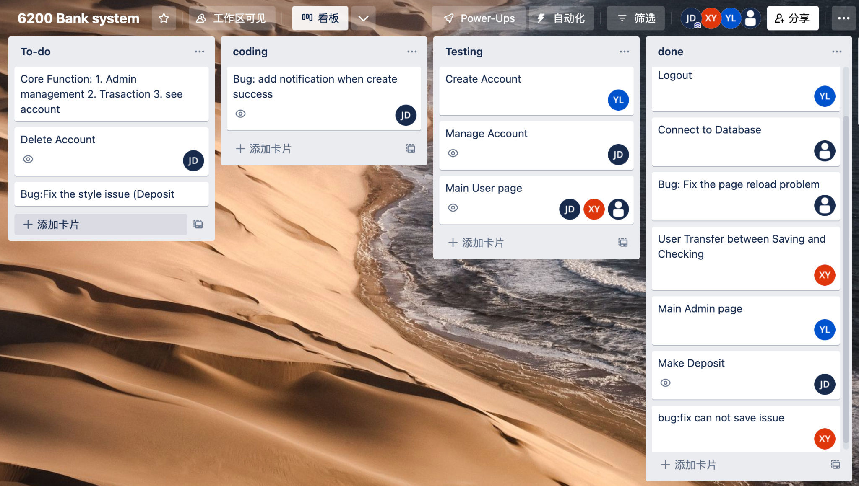
We use Agile development to work together

Slide 4
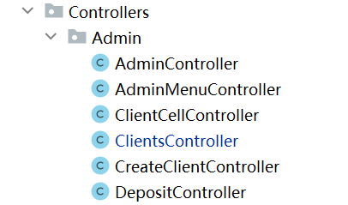
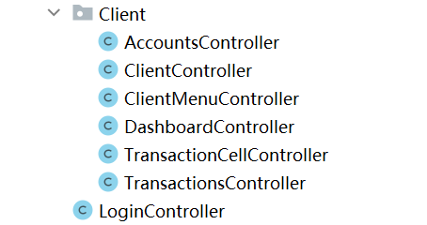
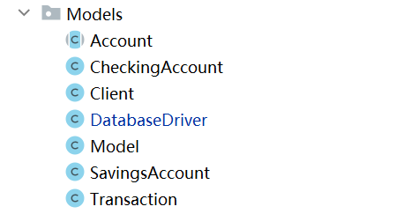
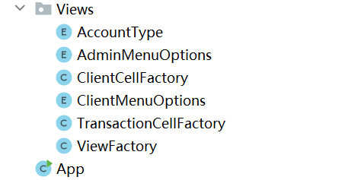
System Design
the purpose of MVC pattern is to implement a dynamic design that simplifies subsequent modifications and extensions to the program, and enables the reuse of a part of the program.
Program has two types of users,admin and client.
admin has access to create,search the client,and can save money to clients.
Clients can check their saving balance,send money to others,achieve saving and checking account transfer,and can check their transactions.

Slide 5
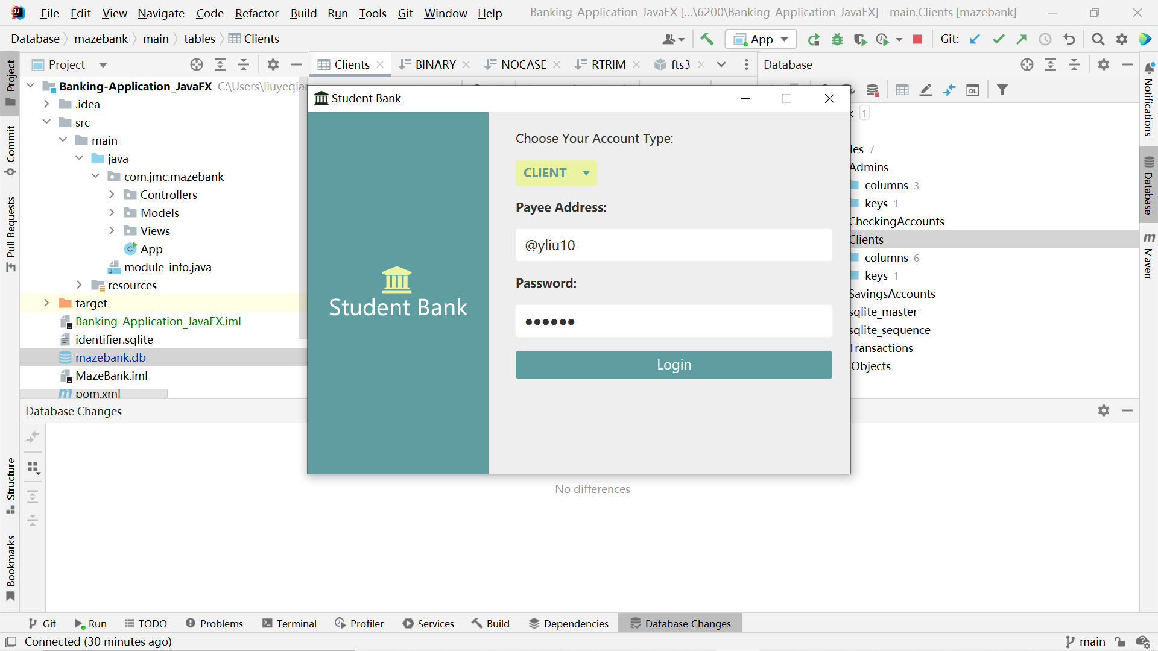
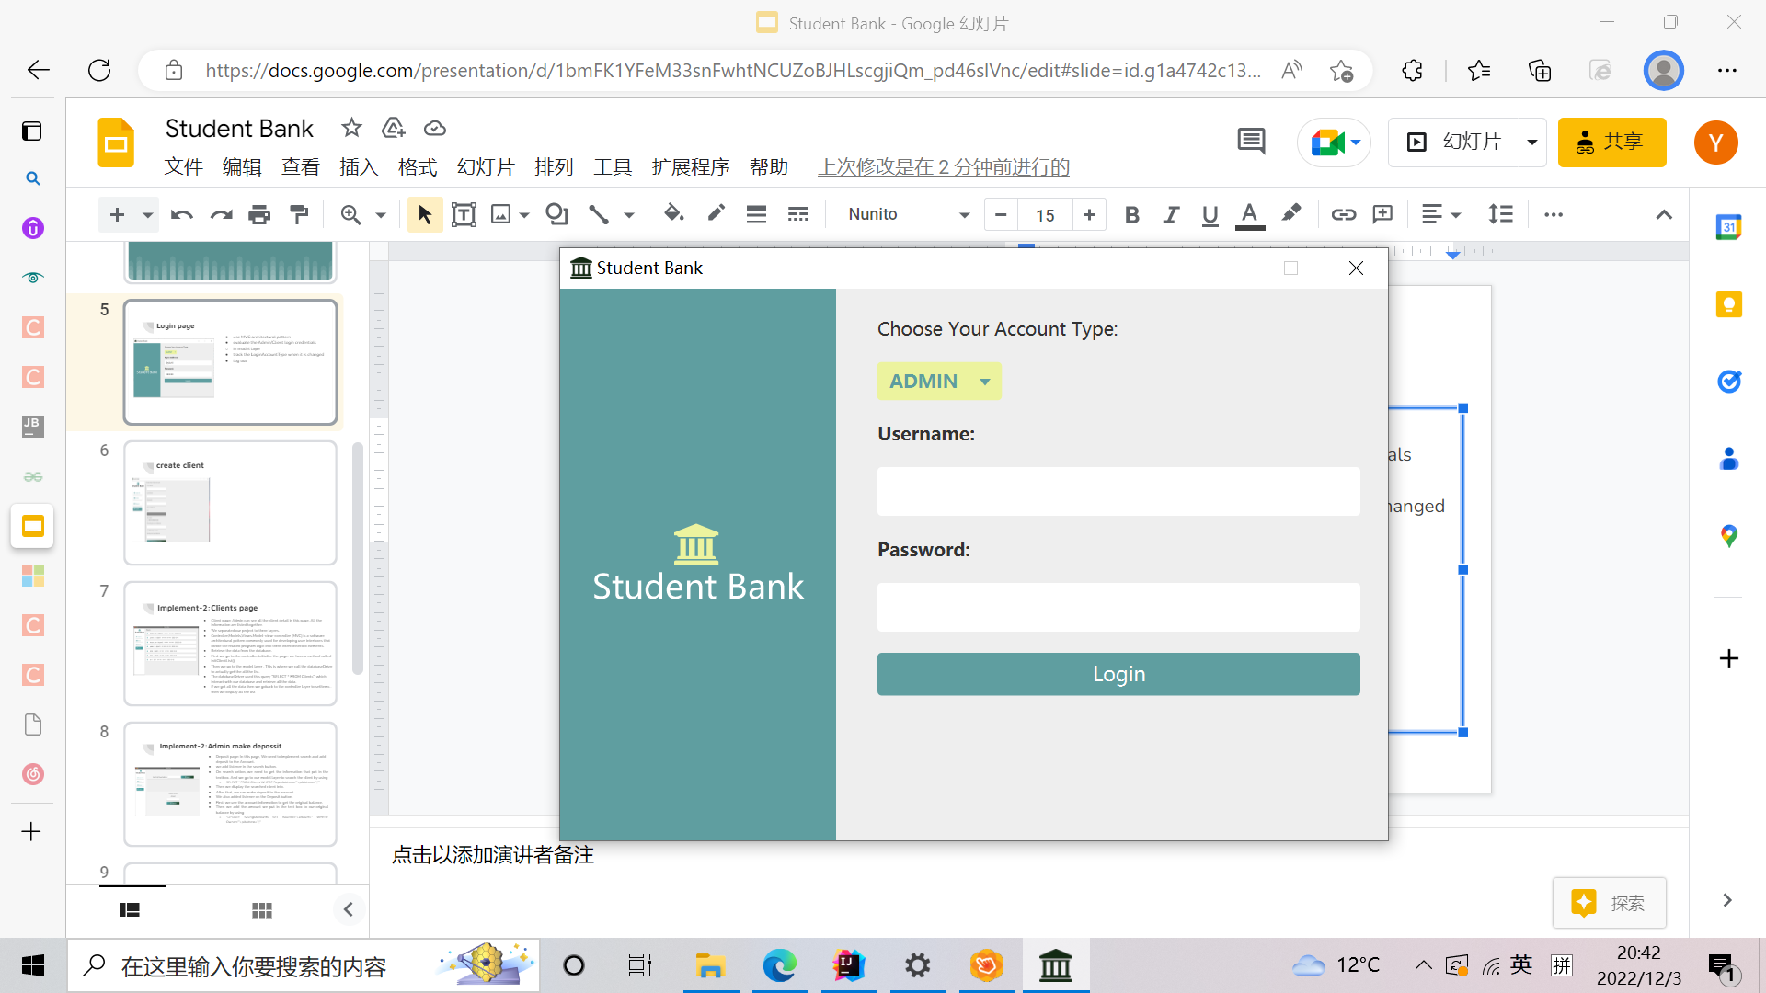
Implement-1: Login page
evaluate the Admin/Client login credentials
pass 2 parameter:PayAddress and Password all matching
in model layer,the datebase driver use select *from clients to get cilentData.
add login successful flag
track the LoginAccountType when it is changed
log out

Slide 6
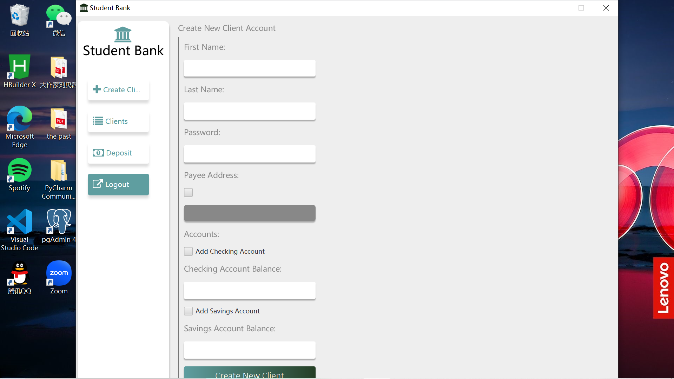
Implement-1: create client
in controller we use fx_id to get the info from input，add listener to check box,clicking the button is bind with the method in controller createClient.
addlistener to Address_box,calling the createPayeeAddress() to generate the character and last Id+1 （back to model layer to retrieve Id for it).
addlistener to Checking/Saving ch_box,in createClient() we have createCheckingAccountFlag
in model layer databaseDriver use “executeUpdate (sql:”INSERT INFO”+..)to update the database

Slide 7
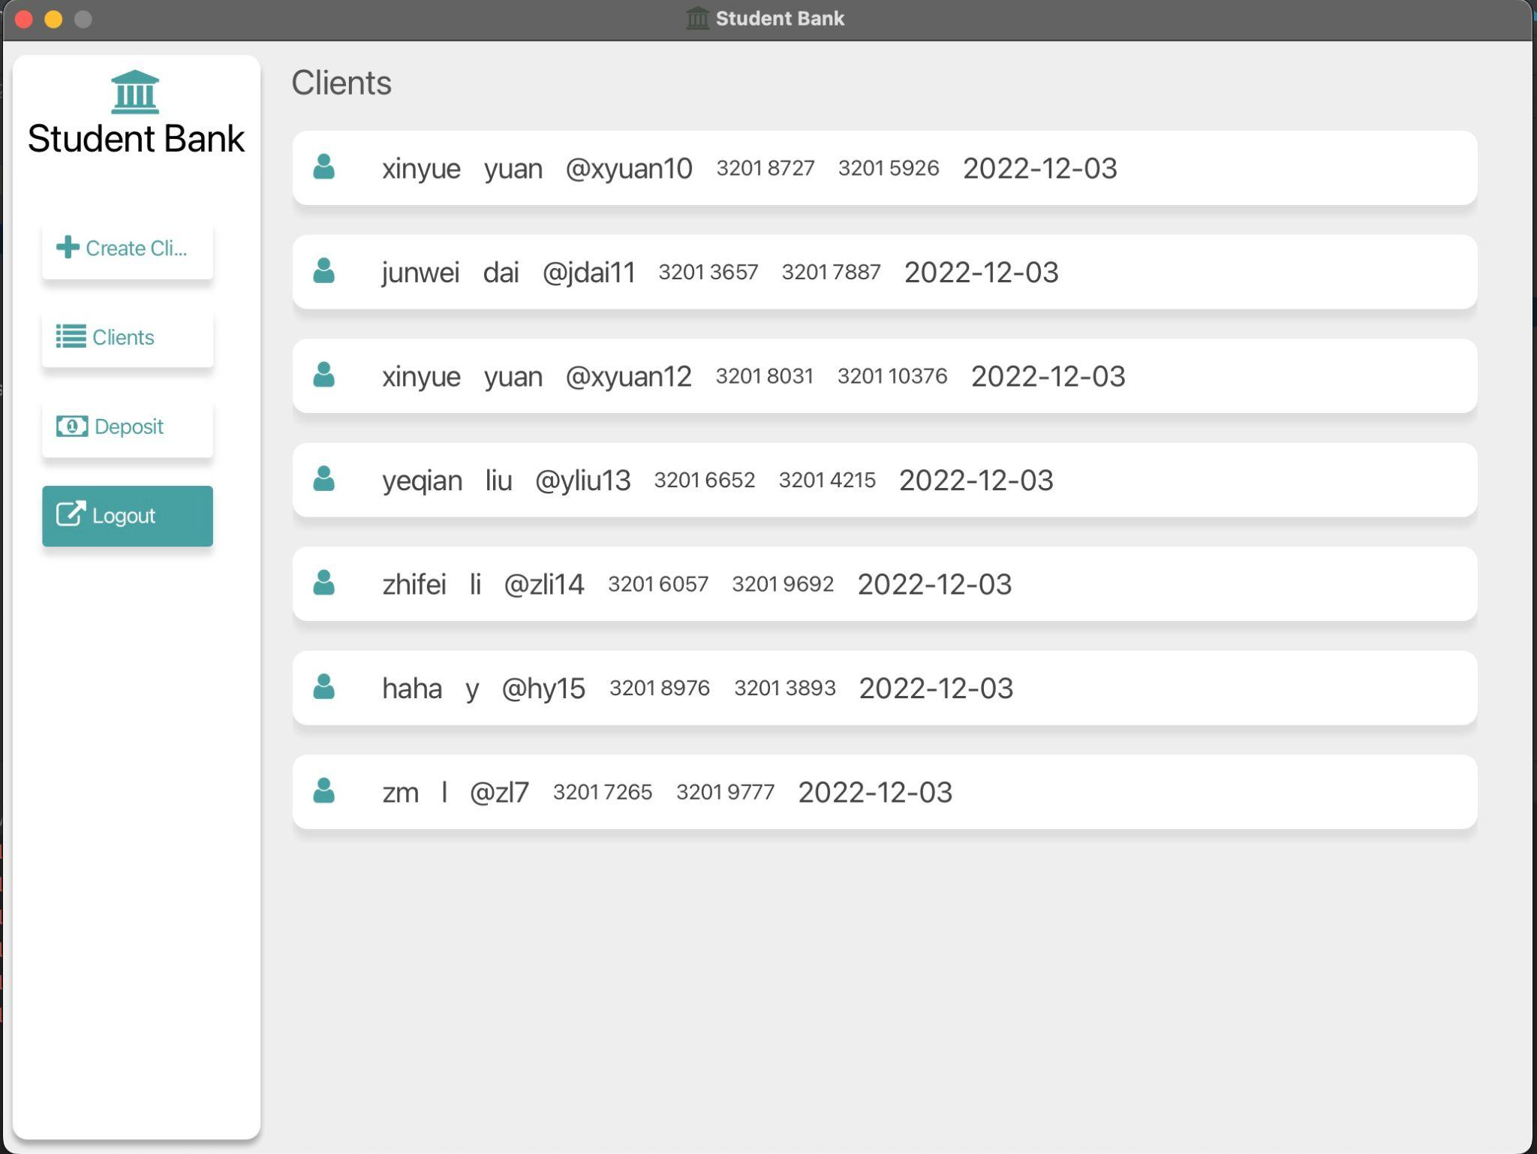
Implement-2: Clients page
Client page: Admin can see all the client detail in this page. All the information are listed together.
We separated our project to three layers.
Controller,Models,Views.Model–view–controller (MVC) is a software architectural pattern commonly used for developing user interfaces that divide the related program logic into three interconnected elements.
Retrieve the data from the database.
First we go to the controller initialize the page. we have a method called initClientList();
Then we go to the model layer . This is where we call the databaseDriver to actually get the all the list.
The databaseDriver used this query “SELECT * FROM Clients”. which interact with our database and retrieve all the data.
if we got all the data then we goback to the controller layer to setItems . then we display all the list

Slide 8
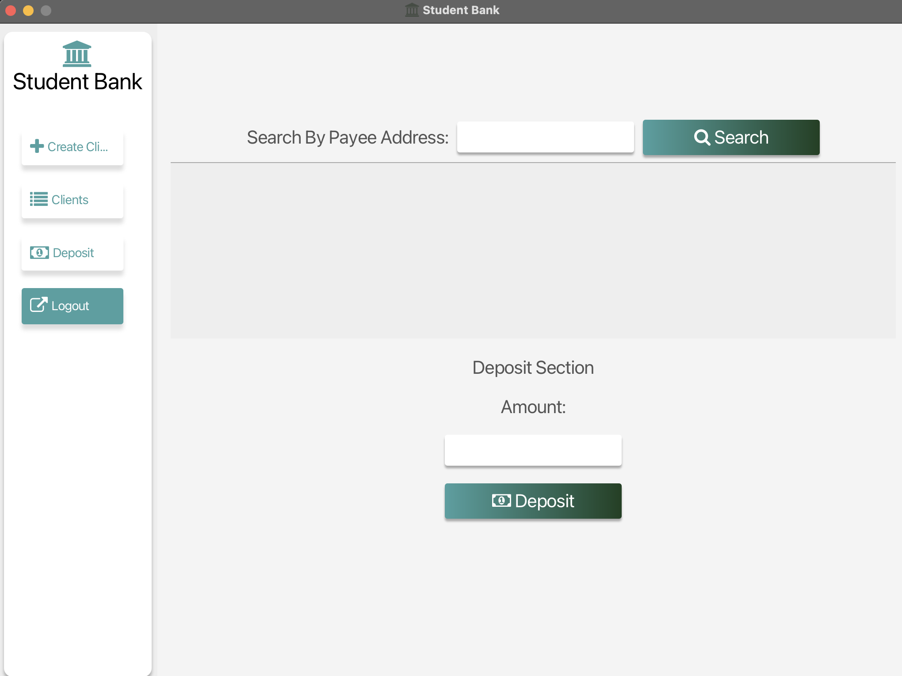
Implement-2: Admin make deposit
Deposit page: In this page, We need to implement search and add deposit to the Account.
we add listener in the search button.
On search action, we need to get the information that put in the textbox. And we go to our model layer to search the client by using
SELECT * FROM Clients WHERE PayeeAddress='"+pAddress+"';"”
Then we display the searched client info.
After that, we can make deposit to the account.
We also added listener on the Deposit button.
First, we use the account information to get the original balance.
Then we add the amount we put in the text box to our original balance by using
"UPDATE SavingsAccounts SET Balance="+amount+" WHERE Owner='"+pAddress+"';"

Slide 9
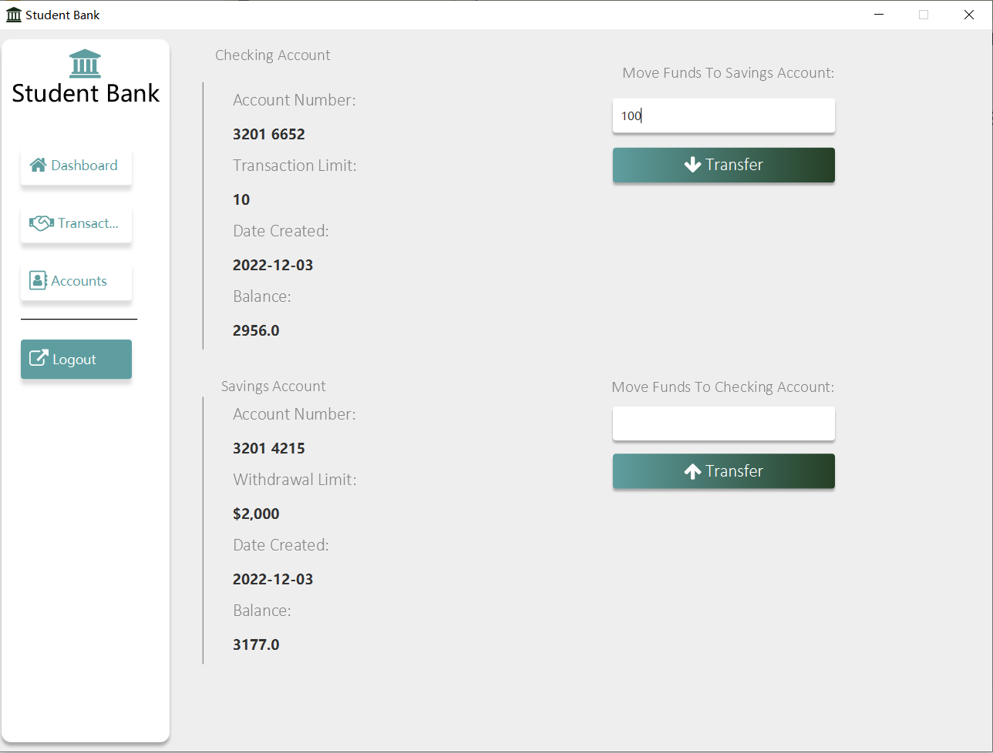
Implement-3: Accounts
Function: This page will present client’s account details. It includes Checking Account, Savings Account, and Transfer functions between Savings and Checking.
Initialize: When initialize this page, account details bound with fx:id will retrieve the data from savings and checking database.
Implement: Client could input money value in the textfield and click the button. After click the button, it will call methods to update the balance data in database. Then use setBalance() method to reset the balance number and show the latest data.

Slide 10
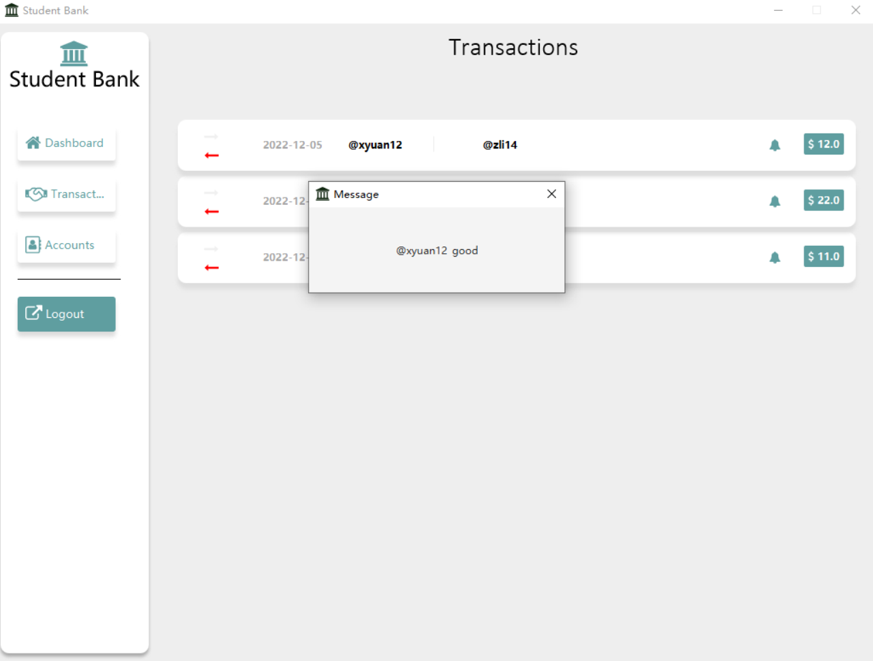
Implement-3: Transactions
Function: This page will present client’s transaction details, the arrow means send or receive money. The first user is sender, the other is receiver. Client could also click the bell icon to see transaction message.
Initialize: When initialize this page, ListView controls will use setItems() method to call getAllTransactions() which will retrieve data from database.
Implement: When client clicks the bell icon, it will new a scene object and present transaction message. Also when client in Dashboard page clicks the Send Money button, this ListView will reload data from database, and transactions page will refresh.

Slide 11
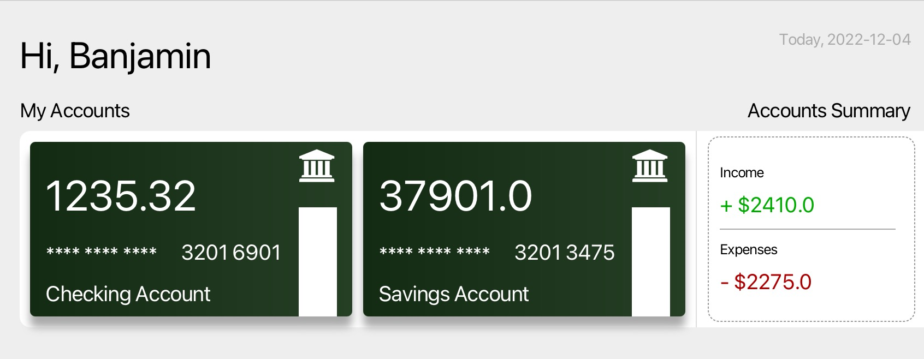
Implement-4: see saving balance
From the card, users can check their saving account and checking account in the dashboard.
First we go to the controller initialize the page. we have a method called bindData();
Then we go to the model layer. This is where we call the databaseDriver to actually get the all the data.
The databaseDriver used this query “SELECT * FROM SavingAccounts”. which interact with our database and retrieve all the data. We use the same way to get the data in CheckingAccounts db.
if we got all the data then we goback to the controller layer to setItems . then we display the data.
We can also get the income and expense in this page.
Use accountSummary() method to bind data in current controller.
We get all transactions of the user and add the num to get result.
the database used this query“SELECT * FROM Transactions” to retrieve data.

Slide 12
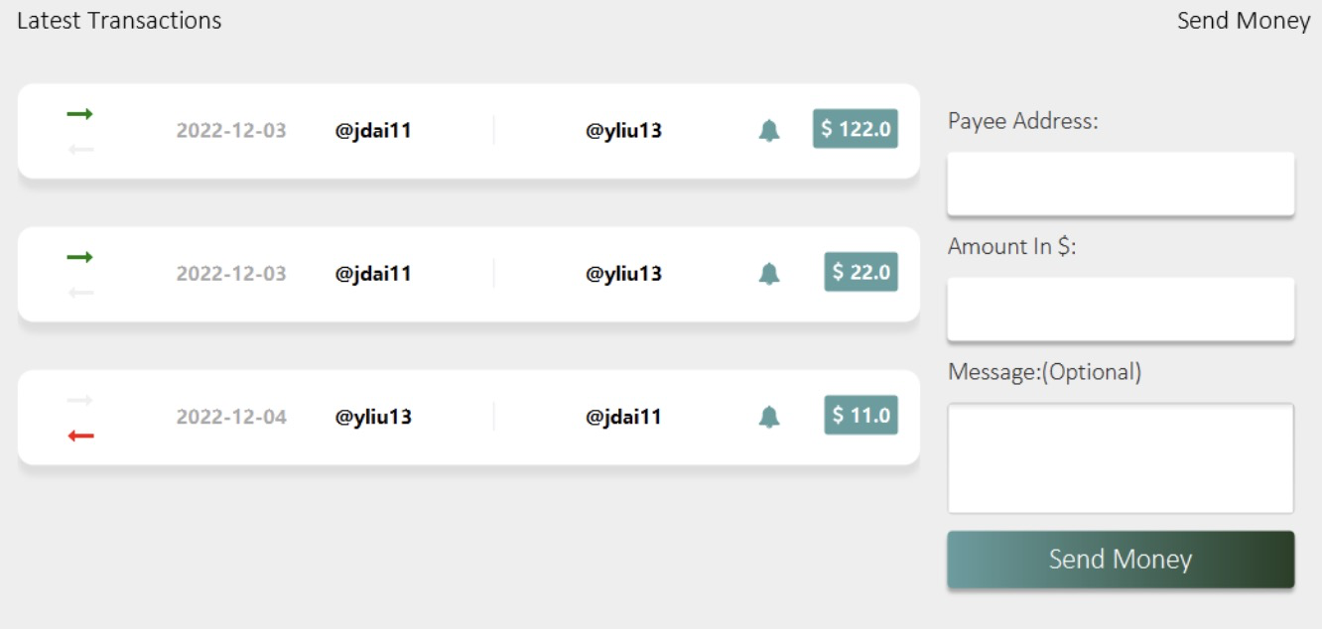
Implement-4: send money to others
Users can send money to others by pAddress.
we have a method called onSendMoney() in current Controller.
Invoked the searchClient() method in databaseDriver directly and used UPDATE SavingAccounts SET statement to update both current user and payee.
Then we go to the model layer. This is where we call the databaseDriver to actually get the all the data.
Invoked the UpdateTransections() and updateExpense() method to keep the data correct.
Users can check the latest four transfer records here.
UInvoked the initLatestTransactionsList() method in controller to get latest data.
Go to the model layer and invoke the database to get the transfer records. Set the limitation as 4.
The databaseDriver used this query “SELECT * FROM Transactions”. which interact with our database and retrieve all the data.
if we got all the data then we goback to the controller layer to setItems . then we display 4 pieces of data.

Slide 13
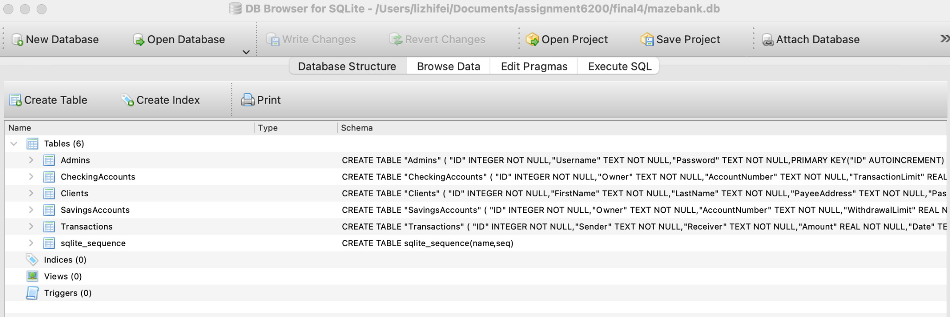
DataBase: Sqlite3
SQLite is an in-process library that implements a serverless and zero-configuration SQL database engine. The code for SQLite is in the public domain and is free for use for any purpose, commercial or private.
SQLite requires no configuration, which means no installation or management. Also, it is very small and lightweight, less than 400KiB when fully configured, and less than 250KiB when optional function configuration is omitted.
We use DB Browser for SQLite as visualization tool to show data. Here are the related tutorials of SQLITE database：https://www.knowledgedict.com/tutorial/sqlite-intro.html
We have 6 collections in db: Admins, CheckingAccounts, Clients, SavingsAccounts, Transactions and sqlite_sequence.

Slide 14
What we learned
What we learned from this project is that we learned the SQLite and how to connect to the javafx . And beside Java we also try to apply the agile development and make our work easier and manageable.
Through this project, we learned to use javaFX for front-end page rendering. As for Java, we used inheritance, Abstract classes, interfaces, and a simple MVC architecture. In addition, I also learned the basic operations about CRUD of SQLite database.
During this project I’ve learned inheritance, interface and javafx. And also the software architecture like how to connect data between front-end and back-end. And the most important is how to work together in a team.

Slide 15
Thanks !

